Slide 1
An Android Application For Keeping Up With The Latest Headlines
-S.P.PUGAZH ARULSELVI
712822104042

Slide 2
DESCRIPTION
A personalized news aggregator that organizes and highlights news stories from around the world:
For You tab: Provides top stories from your favorite topics and sources
Headlines tab: Offers an unfiltered view of top and breaking news articles
Newsstand tab: Allows you to find and follow trusted sources, as well as discover new ones
Full Coverage: Organizes all online coverage of a story from different outlets and mediums
Stories for You: Delivers personalized news based on your interests
Subscriptions: Provides access to your favorite news and magazine subscriptions
Interface: Has a friendly interface that makes it easy to browse through different categories and sources of information

Slide 3
Main Activity.java:
package com.example.newsheadlines
import android.content.Context
import android.content.Intent
import android.os.Bundle
import androidx.activity.ComponentActivity
import androidx.activity.compose.setContent
import androidx.compose.foundation.Image
import androidx.compose.foundation.background
import androidx.compose.foundation.layout.*
import androidx.compose.foundation.shape.RoundedCornerShape
import androidx.compose.material.*
import androidx.compoandroidx.compose.material.icons.filled.Email
import androidx.compose.material.icons.filled.Lock
import androidx.compose.material.icons.filled.Person
import androidx.compose.runtime.*
import androidx.compose.ui.Alignment
import androidx.compose.ui.Modifier
import androidx.compose.ui.graphics.Color
se.material.icons.Icons
import

Slide 4
import androidx.compose.ui.res.painterResource
import androidx.compose.ui.text.font.FontWeight
import androidx.compose.ui.text.input.PasswordVisualTransformation
import androidx.compose.ui.tooling.preview.Preview
import androidx.compose.ui.unit.dp
import androidx.compose.ui.unit.sp
import androidx.core.content.ContextCompat
import com.example.newsheadlines.ui.theme.NewsHeadlinesTheme
class RegistrationActivity : ComponentActivity() {
private lateinit var databaseHelper: UserDatabaseHelper
override fun onCreate(savedInstanceState: Bundle?) {
super.onCreate(savedInstanceState)
databaseHelper = UserDatabaseHelper(this)
setContent {
RegistrationScreen(this,databaseHelper)
}
}
}

Slide 5
@Composable
fun RegistrationScreen(context: Context, databaseHelper: UserDatabaseHelper) {
var username by remember { mutableStateOf("") }
var password by remember { mutableStateOf("") }
var email by remember { mutableStateOf("") }
var error by remember { mutableStateOf("") }
Column(
Modifier
.background(Color.White)
.fillMaxHeight()
.fillMaxWidth(),
horizontalAlignment = Alignment.CenterHorizontally,
verticalArrangement = Arrangement.Center)

Slide 6
{
Row {
Text(
text = "Sign Up",
color = Color(0xFF6495ED),
fontWeight = FontWeight.Bold,
fontSize = 24.sp, style = MaterialTheme.typography.h1
)
Divider(
color = Color.LightGray, thickness = 2.dp, modifier = Modifier
.width(250.dp)
.padding(top = 20.dp, start = 10.dp, end = 70.dp)
)
}
Image(
painter = painterResource(id = R.drawable.sign_up),
contentDescription = "",
modifier = Modifier.height(270.dp)
)

Slide 7
TextField(
value = username,
onValueChange = { username = it },
leadingIcon = {
Icon(
imageVector = Icons.Default.Person,
contentDescription = "personIcon",
tint = Color(0xFF6495ED)
)
},
placeholder = {
Text(
text = "username",
color = Color.Black
)
},
colors = TextFieldDefaults.textFieldColors(
backgroundColor = Color.Transparent
)
)

Slide 8
Spacer(modifier = Modifier.height(8.dp))
TextField(
value = password,
onValueChange = { password = it },
leadingIcon = {
Icon(
imageVector = Icons.Default.Lock,
contentDescription = "lockIcon",
tint = Color(0xFF6495ED)
)
},
placeholder = { Text(text = "password", color = Color.Black) },
visualTransformation = PasswordVisualTransformation(),
colors = TextFieldDefaults.textFieldColors(backgroundColor = Color.Transparent)
)

Slide 9
Spacer(modifier = Modifier.height(16.dp))
TextField(
value = email,
onValueChange = { email = it },
leadingIcon = {
Icon(
imageVector = Icons.Default.Email,
contentDescription = "emailIcon",
tint = Color(0xFF6495ED)
)
},
placeholder = { Text(text = "email", color = Color.Black) },
colors = TextFieldDefaults.textFieldColors(backgroundColor = Color.Transparent)
)
Spacer(modifier = Modifier.height(8.dp))

Slide 10
if (error.isNotEmpty()) {
Text(
text = error,
color = MaterialTheme.colors.error,
modifier = Modifier.padding(vertical = 16.dp)
)
}
Button(
onClick = {
if (username.isNotEmpty() && password.isNotEmpty() && email.isNotEmpty()) {
val user = User(
id = null,
firstName = username,
lastName = null,
email = email,
password = password
)
databaseHelper.insertUser(user)
error = "User registered successfully"
// Start LoginActivity using the current context
context.startActivity(

Slide 11
Intent(
context,
LoginActivity::class.java
)
)
} else {
error = "Please fill all fields"
}
},
shape = RoundedCornerShape(20.dp),
colors = ButtonDefaults.buttonColors(backgroundColor = Color(0xFF77a2ef)),
modifier = Modifier.width(200.dp)
.padding(top = 16.dp)
) {
Text(text = "Register", fontWeight = FontWeight.Bold)
}
Row(
modifier = Modifier.padding(30.dp),
verticalAlignment = Alignment.CenterVertically,
horizontalArrangement = Arrangement.Center
) {

Slide 12
Text(text = "Have an account?")
TextButton(onClick = {
context.startActivity(
Intent(
context,
LoginActivity::class.java
)
)
}) {
Text(text = "Log in",
fontWeight = FontWeight.Bold,
style = MaterialTheme.typography.subtitle1,
color = Color(0xFF4285F4)
)}
}
}
}
private fun startLoginActivity(context: Context) {
val intent = Intent(context, LoginActivity::class.java)
ContextCompat.startActivity(context, intent, null)
}

Slide 13
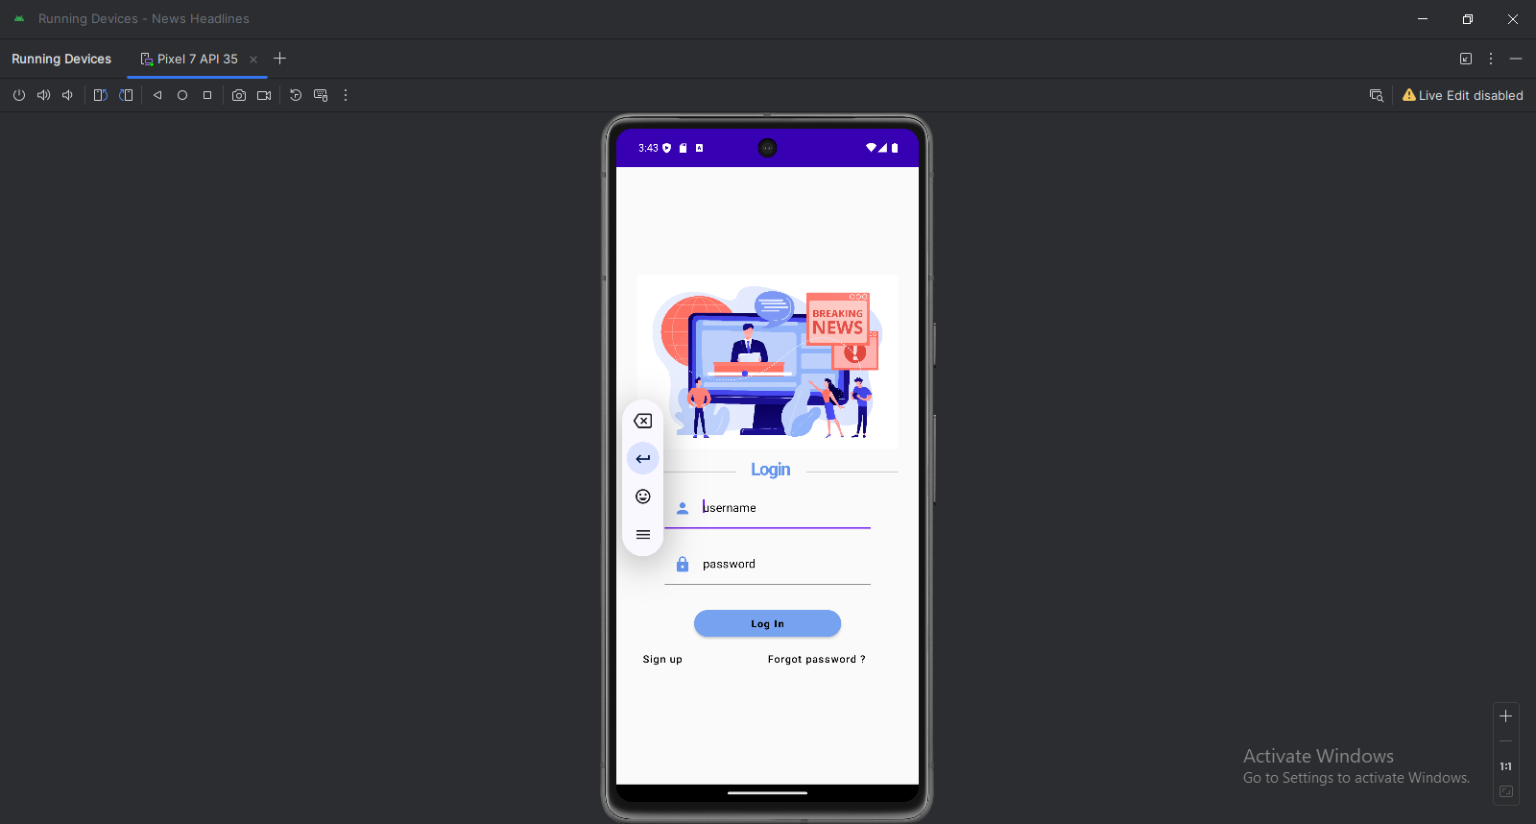
OUTPUT:

Slide 14
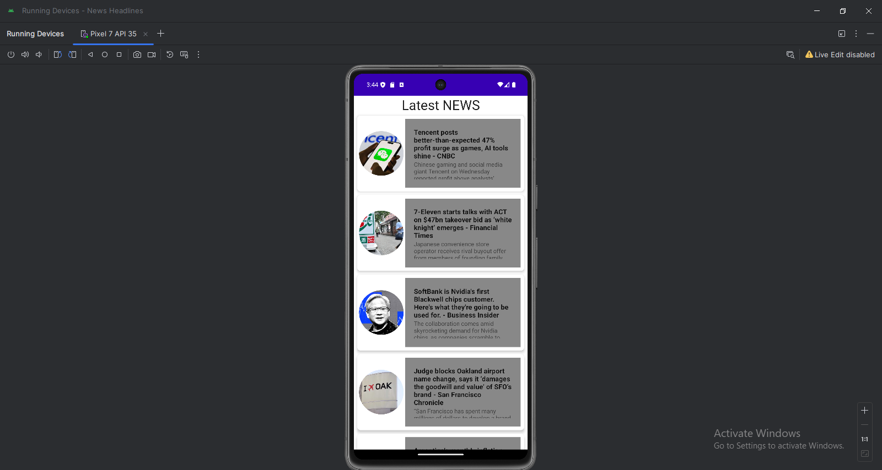

Slide 15


